Slide 1

CS221 Project Presentation Deep Street Extraction
Sruthi Poddutur
poddutur@stanford.edu
Notes:
Hi my name is Sruthi Poddutur.
I am scpd student.
I am going to present my project Deep Extraction
I am sole contributor for the project

Slide 2
Problem and work:
Extracting address from noisy unstructured data
Lack inherent structure or hierarchy
Noisy and long addresses
Multiple sources with different inherent formats
Notes:
This work explores address parsing in particular to helpin standardizing the address by extracting the street information
Task is challenging due to unstructured, lacking in hierarchy mized with long and naoisy addresses from multiple sources

Slide 3
Sample Input:
2255 South Capital Of Tx Hwy Suit 101, West Lake Hills, TX
Vs
Capital of Tx Hwy near Square Mall, Lake Hills, Tx, United States
Notes:
HEre is a quick view of how a typical sample looks like where we have 2 representations for same data

Slide 4
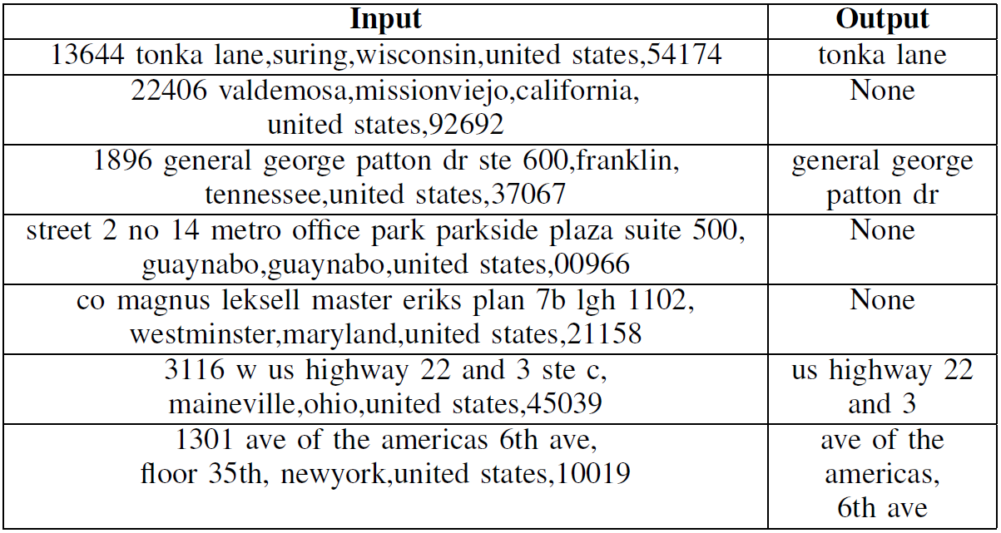
Input and Output:
Notes:
Task is to extract street ifnormation from these long noisy address streams

Slide 5
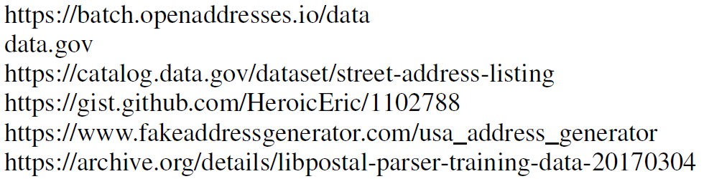
DataSet:
Sampled from
TrainingSize: 50,000
TestSize: 12,000 [1,000 samples in each of the identified 12 categories]
ValidationSize: 5,000
Notes:
Data has been curated from multiple sources (openaddresses.io and here.api being a big help)
I have used 50,000 randomly sampled training data , 12,000 test with 1,000 each in 12 identified categories and 5,000 validation samples respectively

Slide 6
Preprocessing:
Replacing ‘&’ with “and”
Removed all the non-alphabetic charecters except for comma
All numbers are replaced with [NUM] tag
All states are canonicalized Ex: California to CA
Replaced multiple spaces with single space
Notes:
Soruced data had to be prepocessed to handle ampersand, non-alphabetic characters, canonicalization of states etc..

Slide 7
Rule-Based BaseLine:
Rule based Regex extractor
Removed direction from address
Remove prefixes and suffixes
Unit number, floor number, room number, suite, lobby, department, apartment
Regex with anchors
Suffix anchors like hwy, road, rd, bdwy, boulevard, st, street, parkways, pkwy, circle…
Well for address <=5 words only
Notes:
A simple regex rule Based parser has been used as a baseline which performed very well for addresses less than 5 words only as it is easy to com. Up with regex patter in those cases. For longer addresses, it increasingly became difficult to write the needed regex’s.

Slide 8
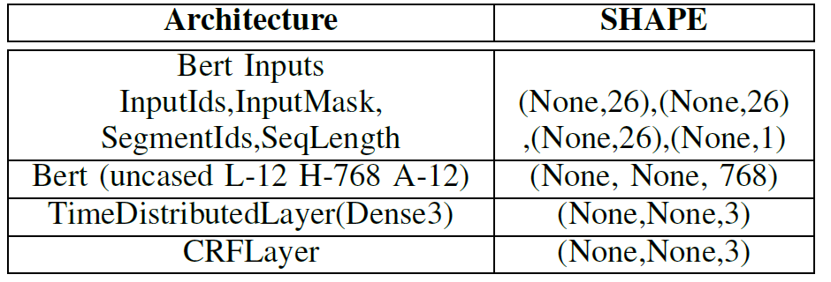
Model Architecture:
Notes:
A simple NER model with CRF layer is training using BERT to embed input.

Slide 9
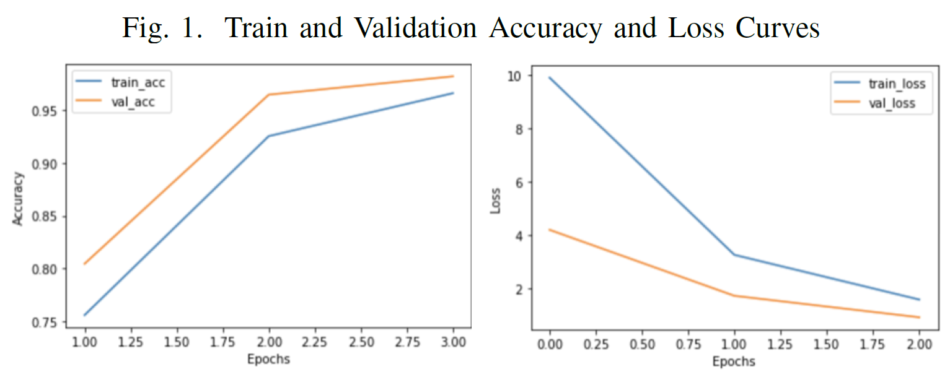
Model Performance:
Notes:
In barely 3 epochs, wegot >95% train and test accuracies

Slide 10
Validation partitioning:
Data divided into 12 buckets for 12 main categories observed amongst all data

Slide 11
Validation bucket 1:
County, State, Local Highways, rural Routes, Highway Contract routes
49137 county highway 17 vergas mn united states of America 56587
1836a state rte 235 greene ny united states of America 13778
92.9% accuracy

Slide 12
Validation bucket 2:
Numbered Streets
586 n e 30th rd 925 n e 80th rd lamar mo united states of America 64759
49th street chapel Vancouver wa united states of America 98660
89.2% accuracy

Slide 13
Validation bucket 3:
Grid style and double directionals
2099 e 4500 s salt lake city ut united states of America 84117
3310 s 2700 e salt city ut united state of america
94.5% accuracy

Slide 14
Validation bucket 4:
Directional as part of street name
1952 west rd new Richmond oh united states of america 45157
9000 southwest fwy ste 410 Houston tx united states of america 77074
80.0% accuracy

Slide 15
Validation bucket 5:
Two suffixes
28045 carriage way dr chester field mi united states of America 48051
9565 nw 40th street rd doral fl united states of America 33178
89.6% accuracy

Slide 16
Validation bucket 6:
Corner Addresses
123 Garcia ln moncks corner sc united states of America 29461
44 Sturgis corner dr iowa city ia united states of America 52246
83.9% accuracy

Slide 17
Validation bucket 7:
Multiple Streets
2nd Joliet st de smet sd united states of America 57231
Avenue n 13th st south Houston tx united states of America 77587
91.8% accuracy

Slide 18
Validation bucket 8:
With Building Names
203 yorktiwn shopping ctr Lombard il united states of America 60148
2 e station square dr pittusburgh pa united states of America 15219
82.7% accuracy

Slide 19
Validation bucket 9:
Spanish culture road names
1194 Avenida amantea la jolla ca united states of America 92037
Mario Julia calle a ste 11a Puerto nuevo pr united states of America 00920
72.3% accuracy

Slide 20
Validation bucket 10:
Big street names
3792 martin luther king jr dr Cleveland oh united states of America 44105
3301 nrighton henrietta town line rd Rochester ny united states of America 14623
84.2% accuracy

Slide 21
Validation bucket 11:
Friendly landmarks
481 1 avenue at 28th st new york ny united states of America 10001
Downtown in the mall Kodiak ak united states of America 99615
83.9% accuracy

Slide 22
Validation bucket 12:
PO Box and Mail addresses
Po box 398 Danville ky united states of America 40423
Po box 682 mc adenville nc united states of America 28101
100% accuracy

Slide 23
Contributions and Conclusions:
Overfitting the neural network when transfer learning with PLM is not bad and infact aids the task
Radom Sampling performs better than Stratified [12 buckets] sampling
Random sampling with augmented additional data helps
Can be attributed to random sample represents domain better
PLM has made this task easy with inherent transfer learning
CRF layer for NER is helpful in learning constraints to final predicted labels

Slide 24
Thanks:
Percy Liang, Dorsa Sadigh, Aditi Raghunathan, Erik Jones
Esp for project guidance from Aditi Raghunathan and Erik Jones

